Slide 1
Objectives
Solve practical problems
Apply industrial standards
1-1

Slide 2
Apply industrial standards
SPOJ Accounts
Full Name
Eiu email
Coding conventions/guidelines/standards
Naming (readable, meaningful name, consistent)
Formatting (readable, good structure, beautiful code)
Why?
Coding practices
“Don’t try to reinvent the wheel”
Prefer using standard library
Good code templates (during the course)

Slide 3
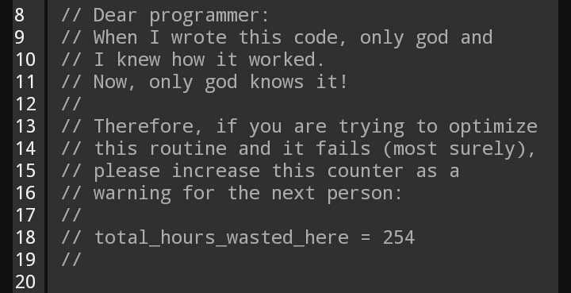
Memes and jokes about everything programming and CS (reddit.com)

Slide 4
Apply industrial standards
SPOJ Accounts
Full Name
Eiu email
Coding conventions/guidelines/standards
Naming (readable, meaningful name, consistent)
Formatting (readable, good structure, beautiful code)
Why?
Coding practices
“Don’t try to reinvent the wheel”
Prefer using standard library
Good code templates (during the course)

Slide 5
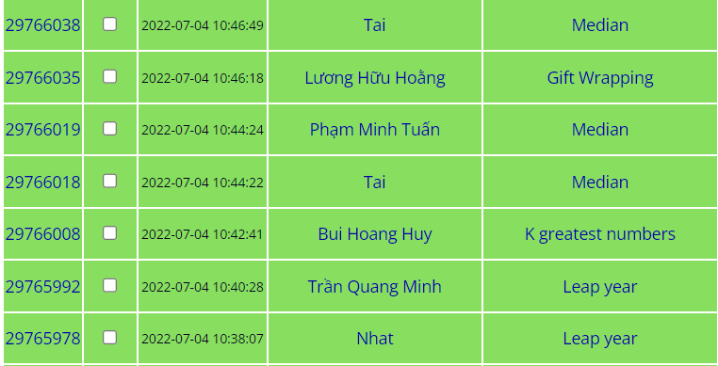

Slide 6
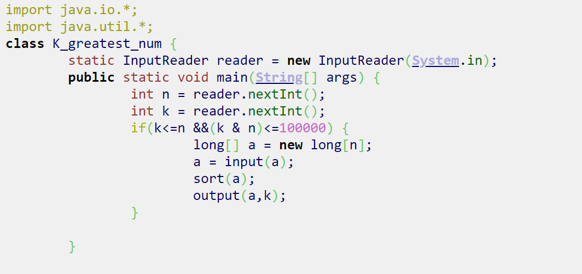
SPOJ submission 29765966 (JAVA)

Slide 7
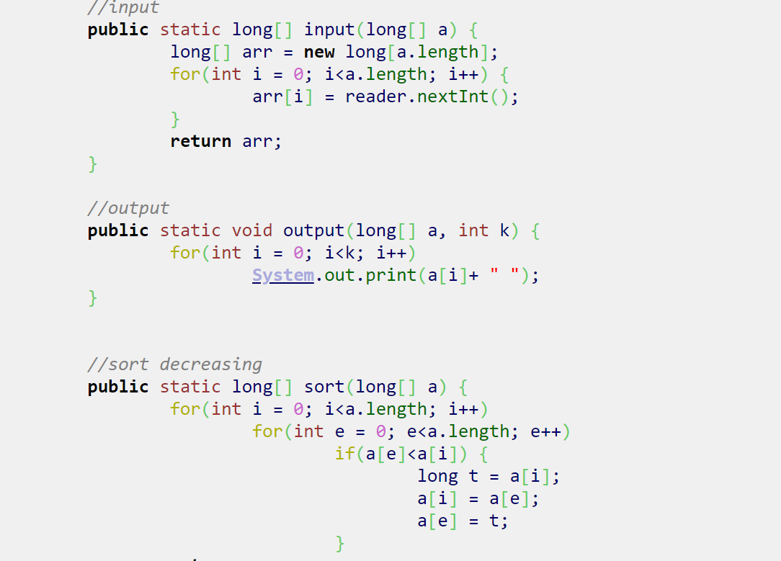

Slide 8
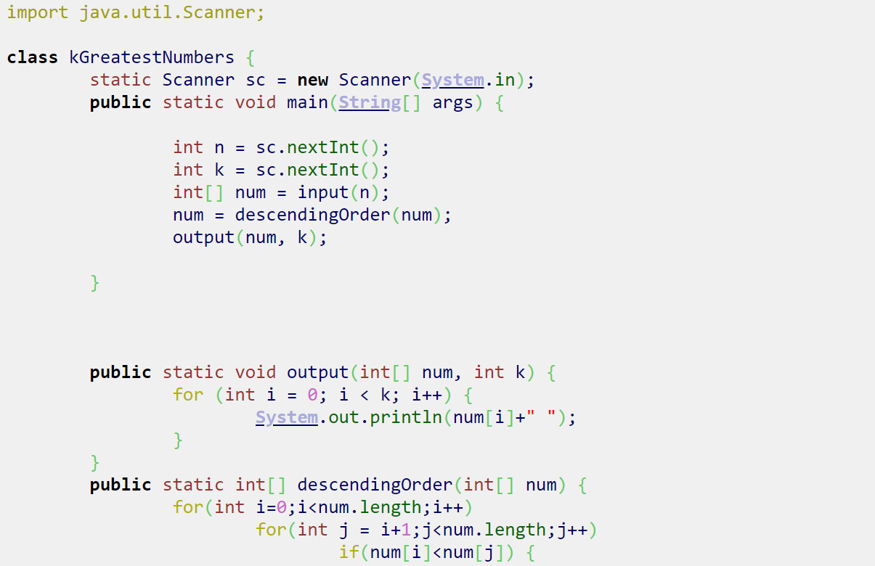
SPOJ submission 29775438 (JAVA)
SPOJ submission result

Slide 9
